Slide 1
Sales Dataset Analysis
Presented by: G.Srilekha
Course: DADS |Batch: [JUNE]
Date: [06-08-2025]

Slide 2
Summary
Objectives and Goals
Dataset & Data Cleaning
Key Metrics & Formulas
Macros & Automation
Pivot Tables & Charts
Interactive Dashboard
Insights & Recommendations

Slide 3

Objectives
Analyze retail sales data to identify trends, improve performance, and build interactive dashboards.
Goals
• Identify sales trends
• Highlight top products and channels
• Build KPI-driven dashboard

Slide 4
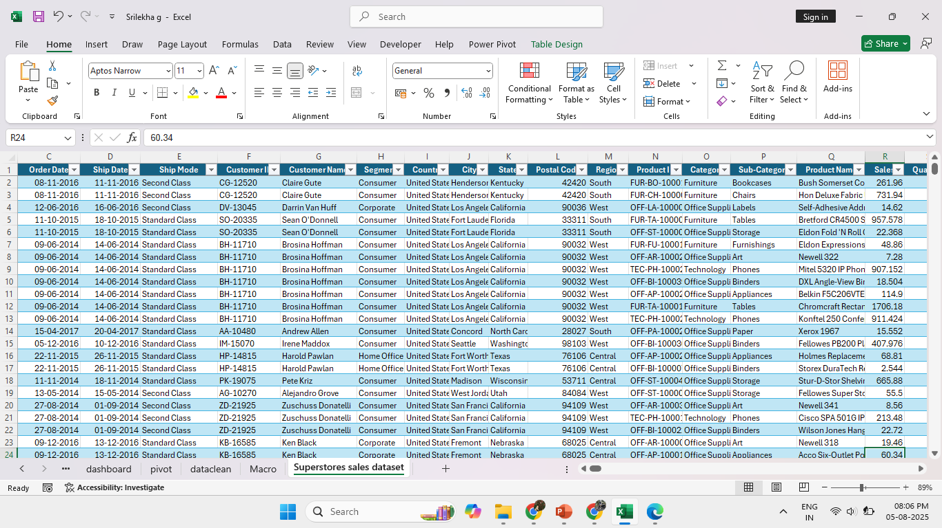
Dataset & Data Cleaning
Dataset Overview:
Rows: ~9994 |
Fields:
Order ID, Sales,
Discount, Ship Mode, etc.

Slide 5
Data Cleaning
Format date columns
👉 Select Order Date and Ship Date → Right-click → Format Cells → Choose Date
Remove duplicate rows
👉 Go to Data tab → Click Remove Duplicates → Select all columns → Click OK
Check and remove blank rows
👉 Use Filter to find empty cells → Delete or fill missing values

Slide 6
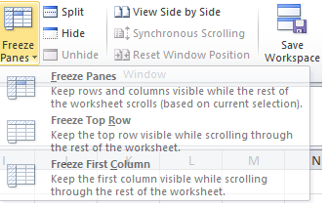
Format number columns
👉 Select Sales, Discount, Profit, Adjusted Sales → Right-click → Format Cells → Choose Currency or Number
Freeze top row
👉 Go to View tab → Click Freeze Panes → Choose Freeze Top Row
Format as Table
👉 Select all data → Go to Home tab → Click Format as Table → Choose a style → Tick "My table has headers“
3. Add Adjusted Sales Column
Column Name | Formula
Adjusted Sales | =Sales * (1 - Discount)

Slide 7
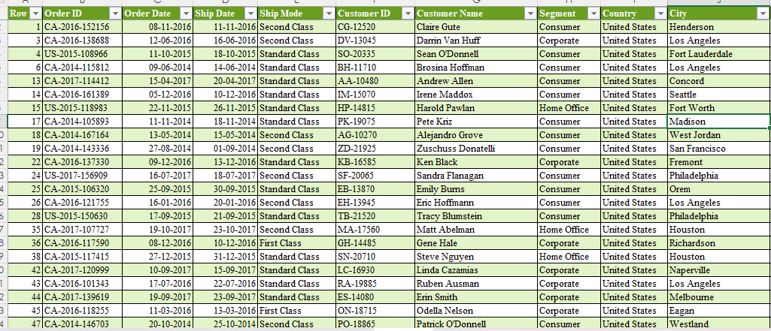
Cleaned Dataset
3. Add Adjusted Sales Column
Column Name | Formula
Adjusted Sales | =Sales * (1 - Discount)

Slide 8
Key Metrics & Formulas
METRIC | FORMULA
Total Sales | =SUM(Sales)
Total Adjusted Sales | =SUM([Adjusted Sales])
Average Order Value | =AVERAGE(Sales)
Total Discount | =SUM(Discount)
Remove duplicates | Go to Data → Remove Duplicates

Slide 9
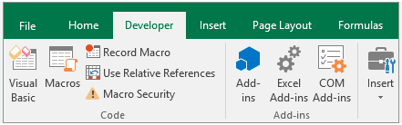
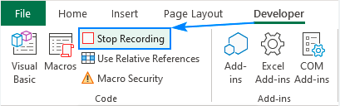
Macros
D eRecordMacro
  Do tasks like formatting, creating a chart
  Click Stop Recording

Slide 10
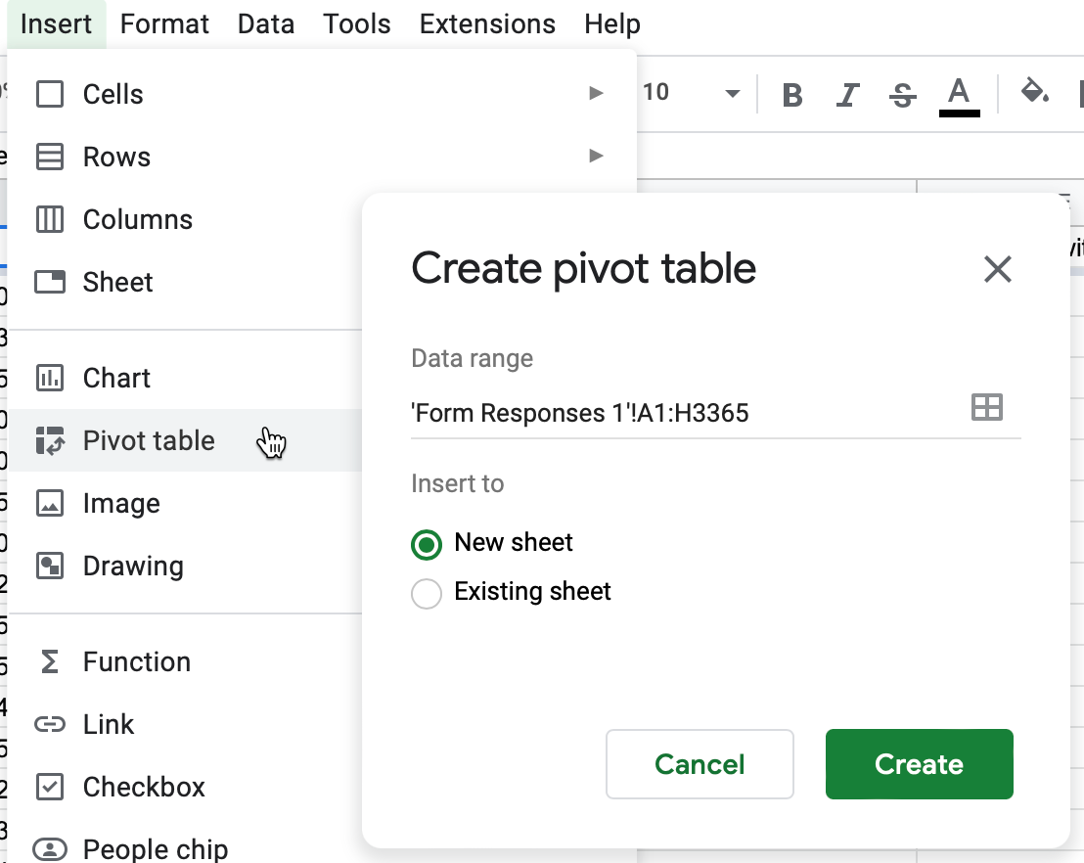
Create PivotTables

Slide 11
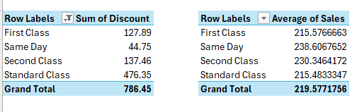
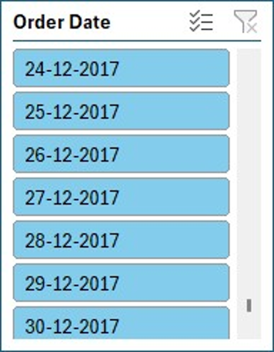
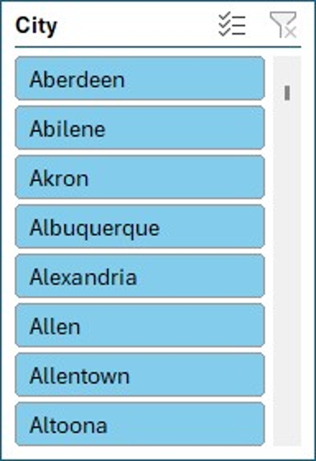
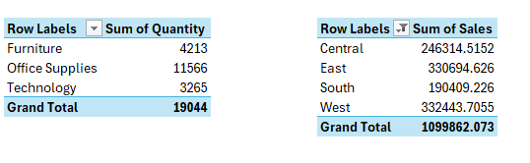
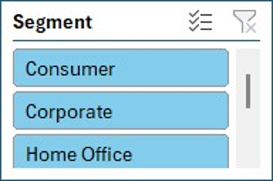
Pivot Tables and Slicer

Slide 12
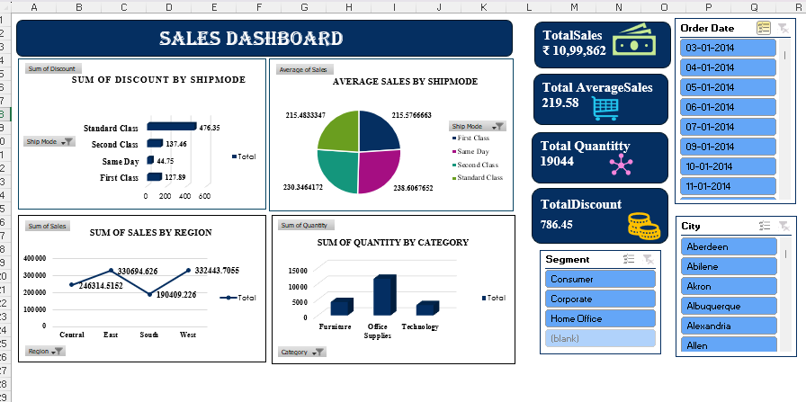

Slide 13
Insights
Total Sales: ₹10,99,862 | Total Quantity Sold: 19,044 |Average Sales per Order: ₹219.58
Highest sales from West region
Standard Class has the highest discount value
Same Day and First Class have higher average sale values
Office Supplies leads in quantity sold
Peak order activity observed in late December 2017

Slide 14
Recommendations
Focus marketing on Office Supplies category
Invest more in West and Central regions
Promote premium shipping with targeted offers
Plan seasonal campaigns around December
Analyze and improve sales in low-performing regions and categories

Slide 15
Thank you

